Slide 1
Prices Too High And Too Low
John Hanger
Hanger Consulting LLC
Hangerconsultingllc@gmail.com
717-412-8477 Twitter:@johnrhanger

Slide 2
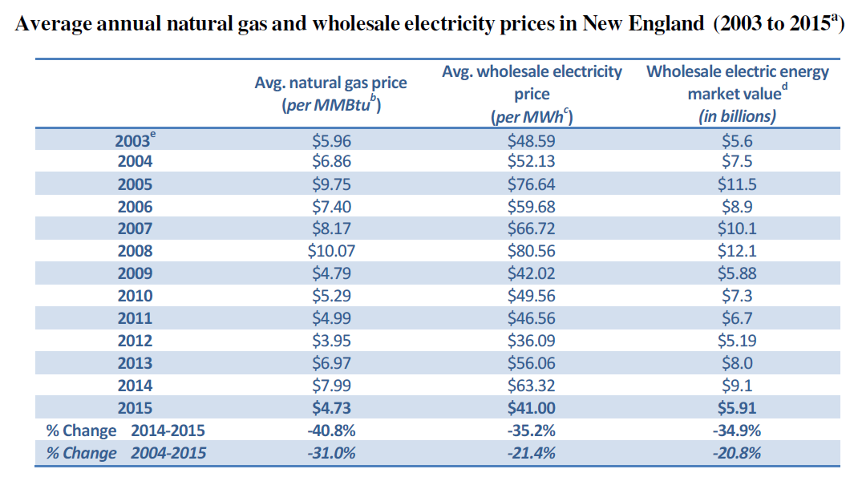

Slide 3
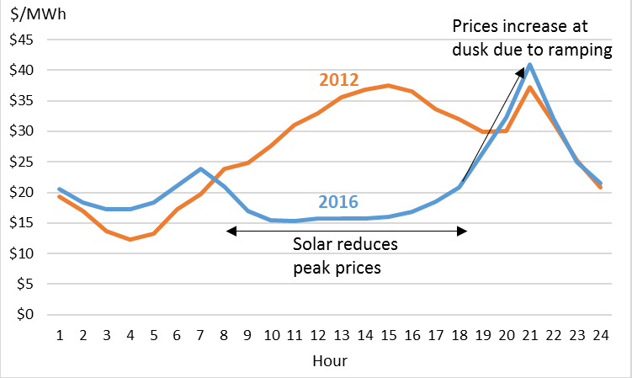
Solar Reshapes Pricing: Creative Destruction?

